Slide 1
Preceptor Training & Assessment
JoAnna Cupp, MS, RDN, LD
Interim Program Director
Figure 1. Coordinated Program in Dietetics. Retrieved from https://www.astate.edu/college/conhp/departments/dietetics/index.dot

Slide 2
Learning Objectives
To review the role of a preceptor and available resources
To review problem student scenarios
To clarify probationary accreditation status and why it is important
To identify strategies to improve the pass rate
To carry out strategies to improve the pass rate
Figure 2. Skills Competence Knowledge Success. Retrieved from https://pixabay.com/en/skills-competence-knowledge-success-3270306/

Slide 3
Coordinated Program in Dietetics
2 year-undergraduate program
  Bachelor of Science in Dietetics
In order for students to be able to take the Commission on Dietetic Registration licensing exam to become registered dietitian nutritionists (RDNs), they complete required course work from an accredited program along with 1200 mandatory supervised practice hours.
Preceptors
  Assist students in completing of the 1200 hours of mandatory supervised practice

Slide 4
5 Supervised Practice Rotations
Practicum I School Foodservice 168 Hours
Practicum II Hospital/Nursing Home Foodservice & Community 360 Hours
Practicum III Community 168 Hours
Practicum IV Clinical 168 Hours
Practicum V Clinical 360 Hours
Total: 1,224 Hours

Slide 5
ACEND Requirements
Accreditation Council for Education in Nutrition and Dietetics
10 standards
  6 involve preceptors
Eligibility for ACEND Accreditation
Program Characteristics and Resources
Consortia
Program Mission, Goals, and Objectives
Program Evaluation and Improvement
Curriculum and Learning Activities
Student Learning Outcomes Assessment and Curriculum Improvement
Faculty and Preceptors
Supervised Practice/Experiential Learning Sites
Information to Prospective Students and the Public
Policies and Procedures

Slide 6
Role of an Effective Preceptor
Assessor of Learning
Facilitator
of Learning
Resource
Developer
Role Model
Figure 3. Role Model. Adapted from the Academy of Nutrition and Dietetics Commission on Dietetic Registration Online Preceptor Training Program; available at http://www.cdrcampus.com/
Information
Provider
Planner

Slide 7
History of the
Coordinated Program in Dietetics
Housed in the Nutritional Science Program, College of Nursing and Health Profession
2012: Accepted 1st class of students
2014: Inaugural class graduated
2016: Awarded Accreditation Status
2018: Placed on Probationary Status due to the pass rate

Slide 8
Why? Pass Rate Improvement
Keep accreditation
Graduate competent entry level professionals
Graduate students that will pass the CDR exam
Contribute to the profession
Keep positive reputation of A-State and the Coordinated Program in Dietetics

Slide 9
Strategies to Improve the
Pass Rate

Slide 10
Strategic Plan/Recommendations
Admission Requirements of the Program
  Implemented an entrance exam (HESI A2)
  Accept Higher GPA
Program Curriculum
  Involve faculty, staff, and students in efforts to improve
  Weight specific courses throughout the program
Faculty
  Implemented Exam Review Course to help students identify weak areas
  Implemented Summer Workshop for Seniors prior to graduation

Slide 11
Strategic Plan/Recommendations
Preceptor Training
  Seek preceptor feedback
Evaluation Feedback
  Gather from students
  Gather from preceptors
Surveys completed former Graduates
  Give Qualtrics Surveys
Figure 4. Survey. Retrieved from https://pixabay.com/images/search/survey/

Slide 12
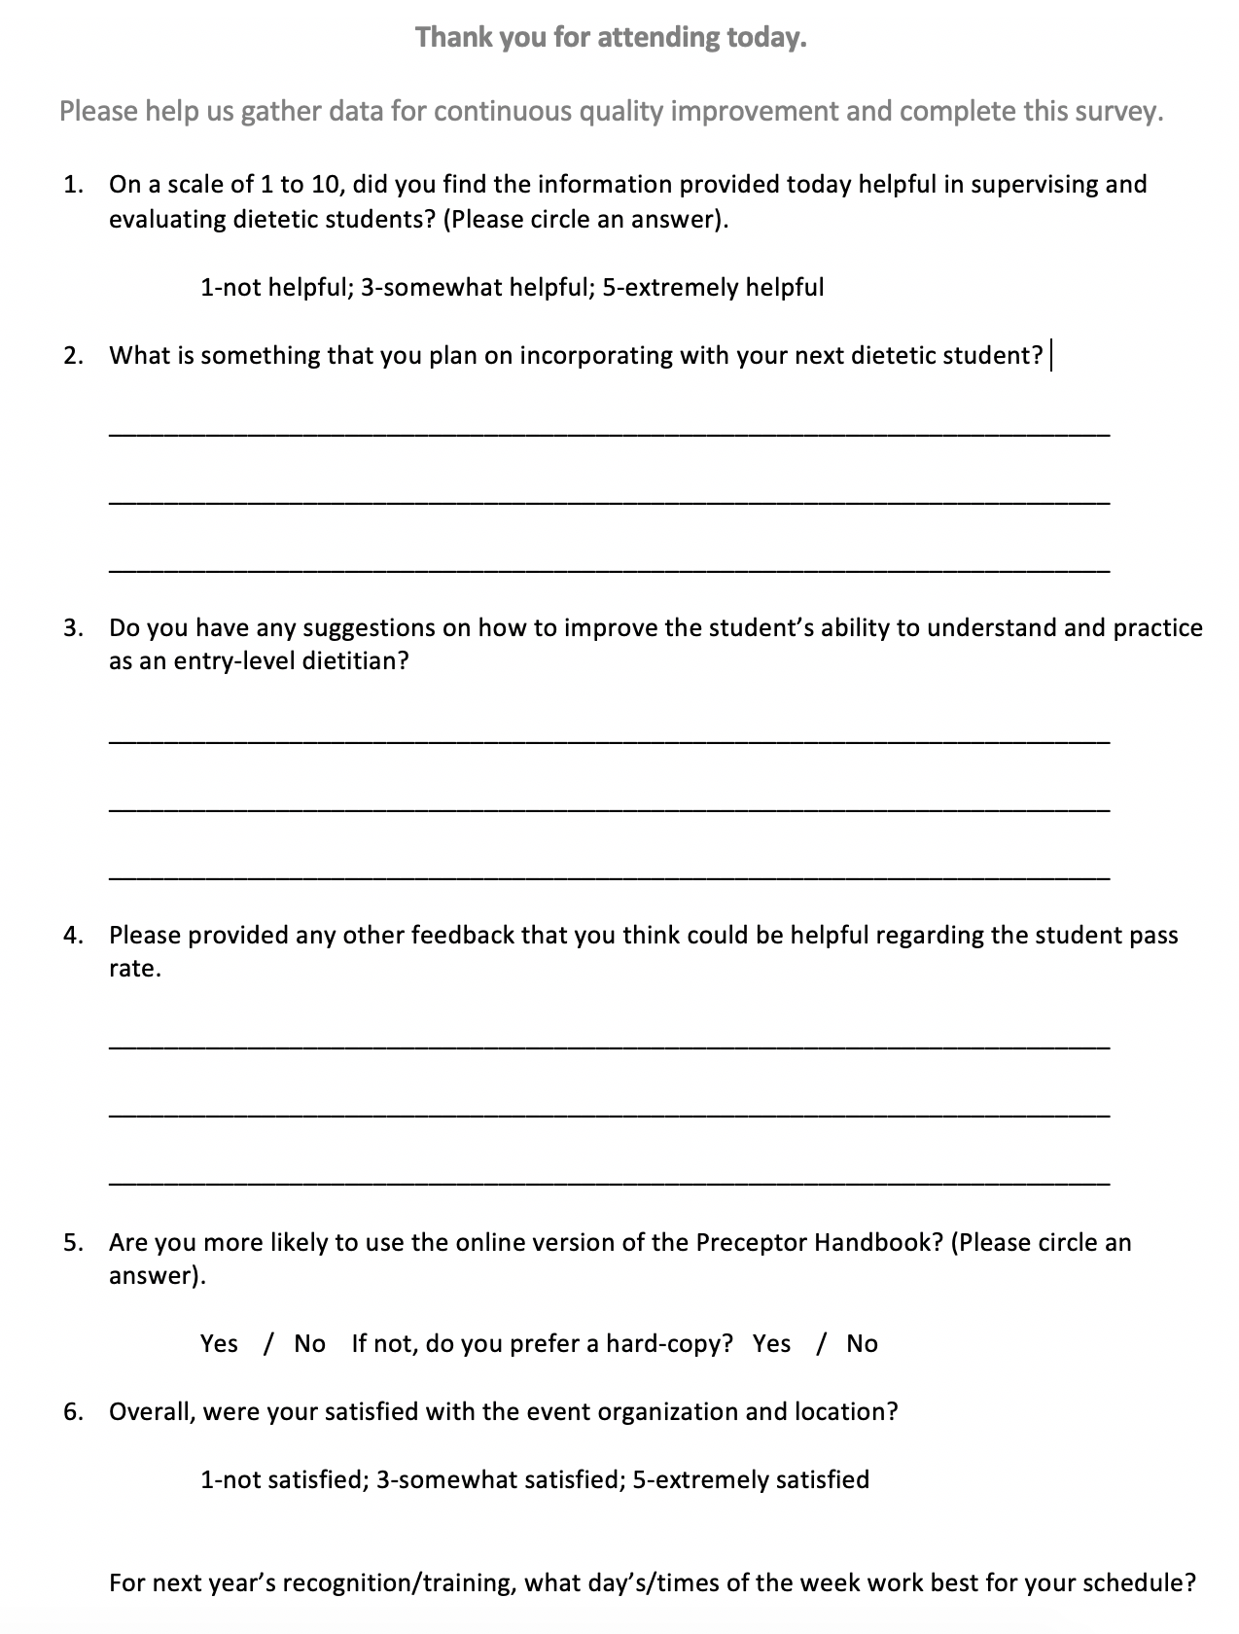
Survey to be given to preceptors at training

